Slide 1

ManiPlant (Autoreferral system for SpringRole)
Science India Hackathon
January 24th-25th, 2015

Slide 2



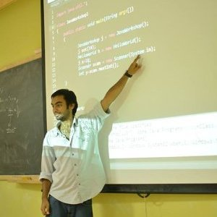

The Team
Nagaraj Nayak
Android Developer at Sourcebits
Skills: Java, Android, MySQL
Vamshi Reddy
Software Deveopment Intern at Citrix India
Skills: Networking, Systems, Python
Pranay Pareek
Developer at Shippable
MEAN stack
Saumye Srivastava
Batman
Skills: Everything, duh?

Slide 3
The Problem
No time to go through referrals/recommendations.
Complicated system of referring someone.
Low on cash. ($?)

Slide 4
Solution: ManiPlant

Slide 5
Yes! You’re right. ManiPlant ;)

Slide 6
How does it work?
Step 1: Register on the app by authenticating your Linkedin and Springrole account. Two step Linkedin login. Yes we store your credentials.
(There is a pretty good market for private details :D)

Slide 7
How does it work?
Step 2: Let us sync all your Linkedin contacts so that you can search and rank their top 2 skills.

Slide 8
How does it work?
Step 3: There is no step 3.
We have stored your contact’s top skills according to you. If a new job is added to Linkedin and your friend has the skills, we automatically send a recommendation from your side for him to Springrole.

Slide 9
How does it work?
Step 3.01:
If he gets the interview or the job, you earn.

Slide 10
How does it really work?
<geekdetails>
After the authentication, the user’s 1st degree connections’ details are stored on the app (SQLLite DB). The user can choose to submit their/anyone’s top 2 skills which are stored on our server.(Procastination counts)
<backend>
backEnd();
</backend>
If the job requirement, matches the skills a message is sent to him.
</geekdetails>

Slide 11
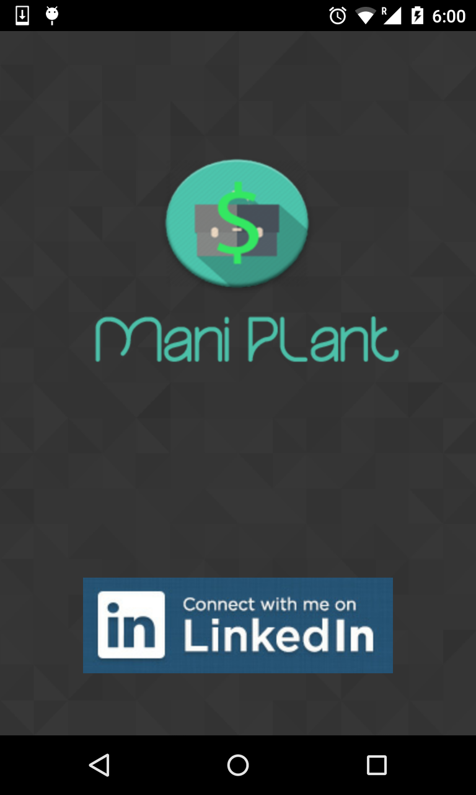

Slide 12
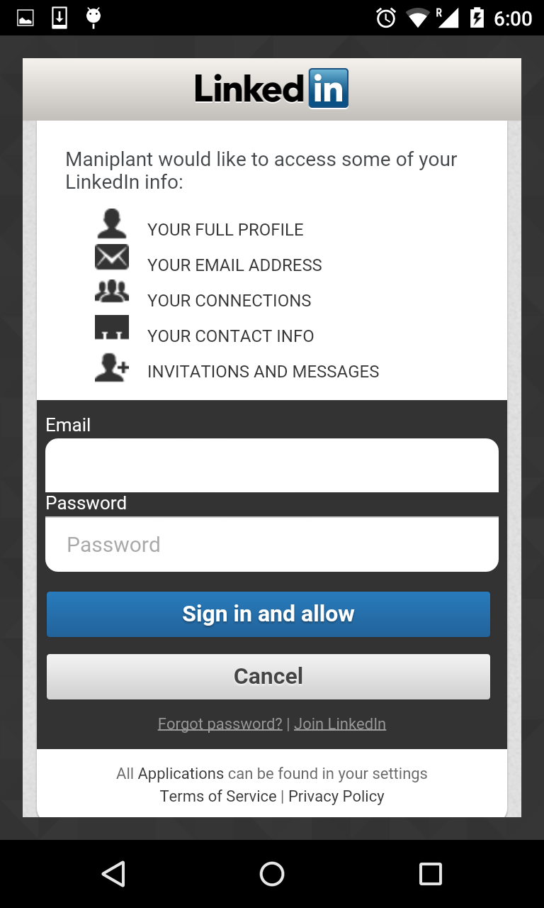

Slide 13
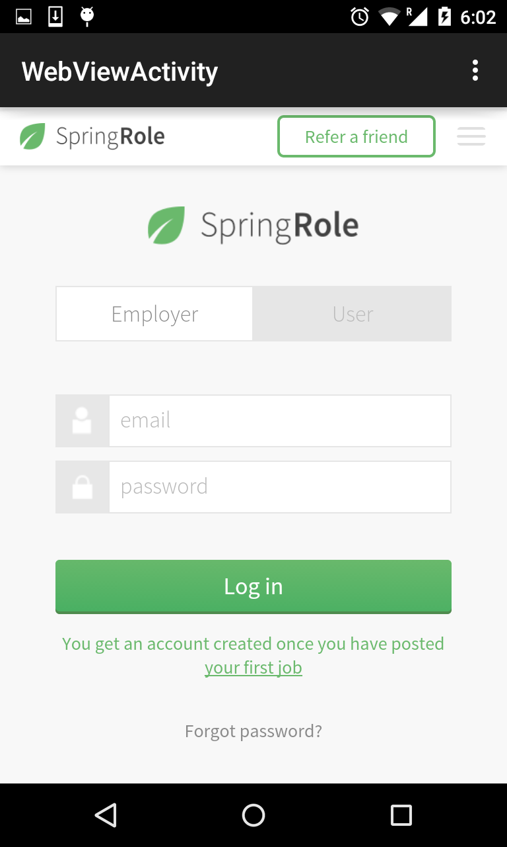

Slide 14
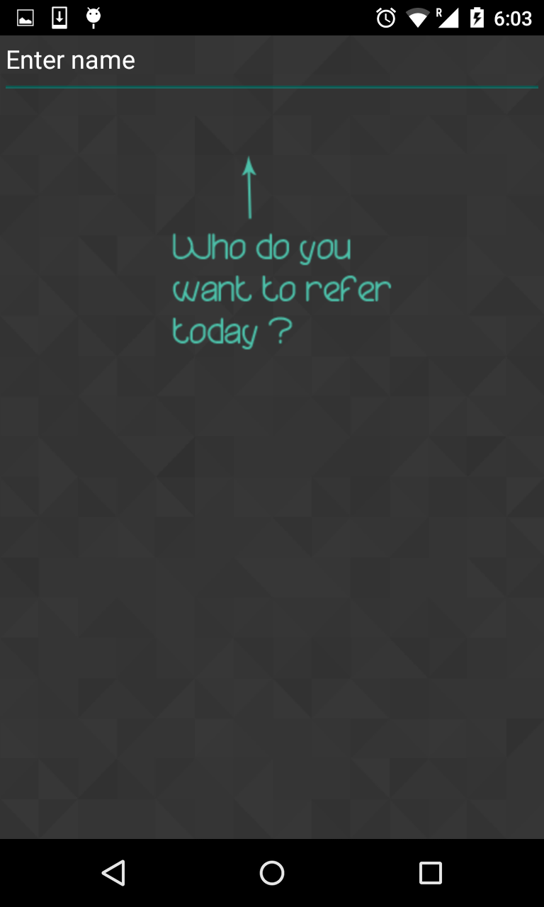

Slide 15
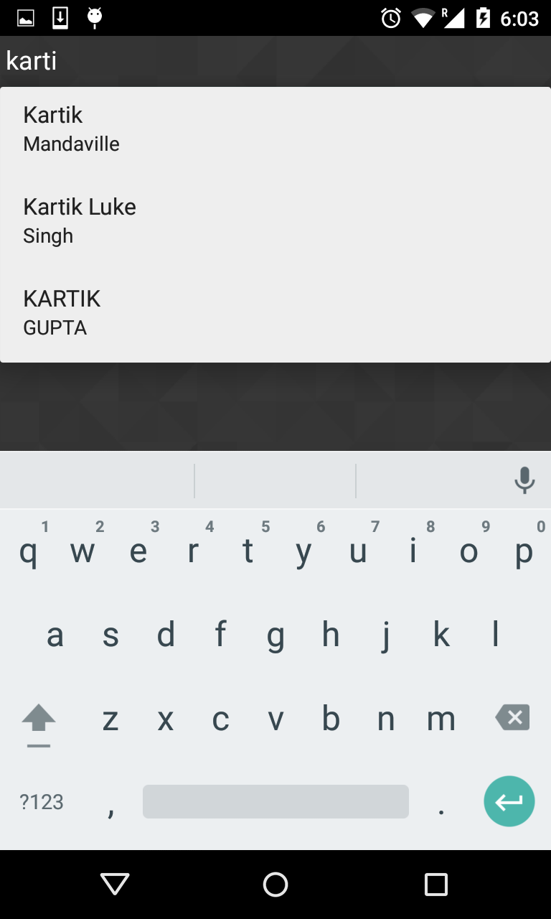

Slide 16
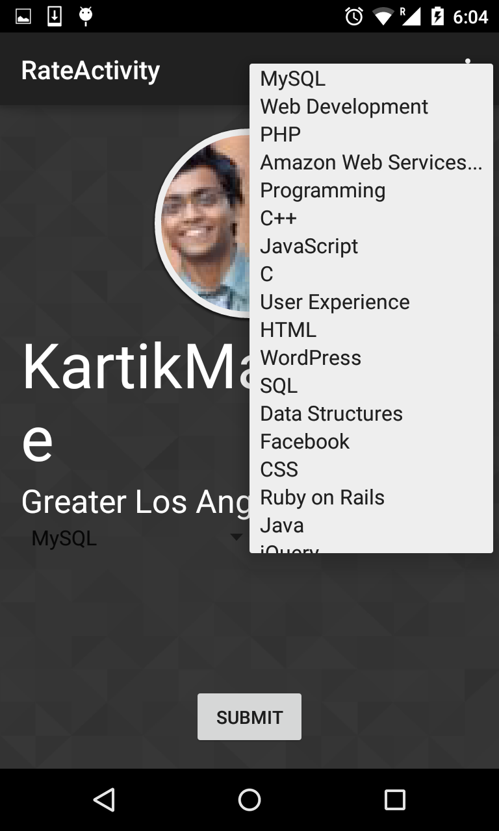

Slide 17
Product Features
Automatic referral system == $$$
Bot to monitor new jobs and post on behalf of user
SEO content
Sort by tags

Slide 18
Technology Achievements
Android
Back-end:
APIs written in Node
Auto-Worker (Python)
BeautifulSoup for
scraping LinkedIn Skills
MongoDB for Database
on the back-end

Slide 19
Conclusion
Github access: https://github.com/pranaypareek/maniplant.git
https://github.com/vamshireddy/springrole-worker.git

